Slide 1
Data Mining Regression Analysis
Ehsan Mirzaei
Jun 2022

Slide 2
What is Regression Analysis?
A statistic method to describe the relationship between a set of independent variables.
To assess in what extent a predictor variable is relevant to predict the target behavior.
It allows to establish casual relationships explanatory technique.

Slide 3
Regression Analysis - Example
Predict customer / employee churn
Detect fraudulent cards
Detect main risk factors in a disease
Predict the price of a house
Predict sales amount
.
.
.

Slide 4
Linear vs logistic Regression
Linear regression is used to predict the continuous dependent variable using a given set of independent variables.
Logistic Regression is used to predict the categorical dependent variable using a given set of independent variables

Slide 5
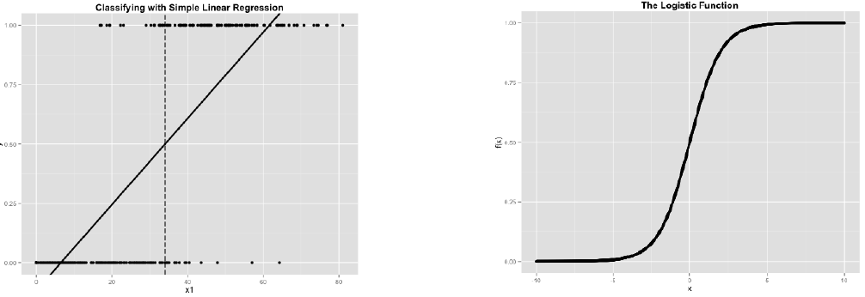
Linear vs logistic Regression
Linear Regression
Predict sales amount.
Predict the growth of the economy.
Predict the price of a house.
Logistic Regression
Predict elections outcome.
customer decision on whether buy or not a product.

Slide 6
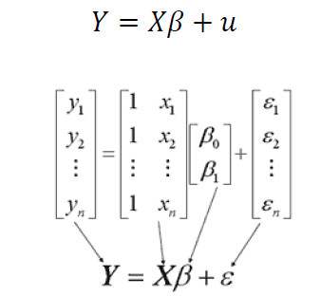
Linear Regression (The theoretical model)
The aim is to study the effect of one or more factors quantitative or qualitative variables / predictors ) on a quantitative variable target.
The theoretical model is:
𝑦𝑖 is the dependent / target variable observed for individual i.
𝛽𝑖 the parameter associated with predictor variable k
𝑥𝑘𝑖 the independent / predictor variable k observed for individual i.
𝑢𝑖 the error for individual I
matrix notation

Slide 7
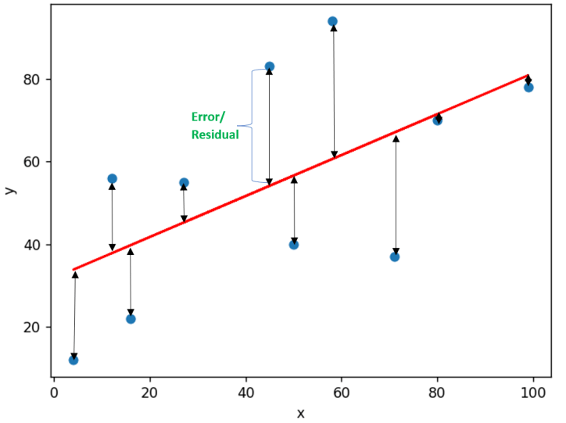
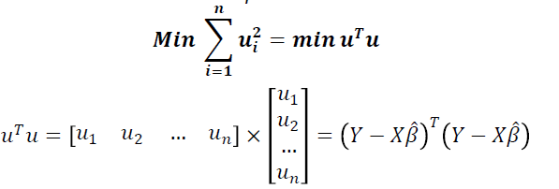
Linear Regression (Ordinary least squares (OLS) )
Ordinary least squares (OLS) regression is a statistical method of analysis that estimates the relationship between one or more independent variables and a dependent variables.
The method estimates the relationship by minimizing the sum of the squares in the difference between the observed and predicted values of the dependent variable configured as a straight

Slide 8
Logistic Regression
Linear regression serves to predict continuous Y variables , logistic regression is used for binary classification.
If Y is multi classification problem, it’s not possible to use logistic regression.
EXAMPLES
Spam detection: is a email Spam or not?
Credit Card Fraud: is a given card transaction fraud or not?
Banking : will a customer default on a loan or not?

Slide 9
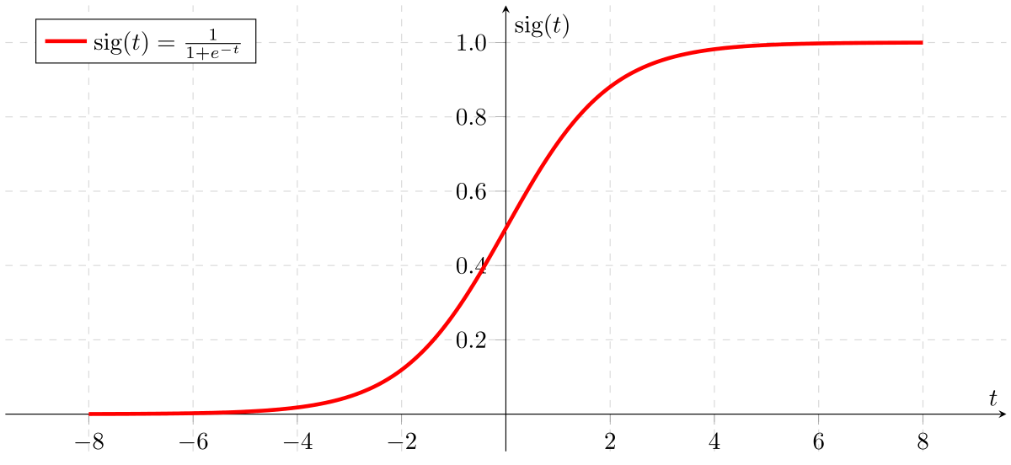
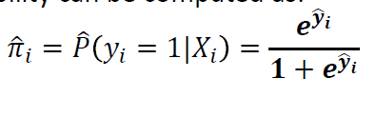
Logistic Regression
In logistic regression, input features are linearly scaled just as with linear regression; however, the result is then fed as an input to the logistic function.
logistic regression function

